Slide 1
Student affairs system schema
From ERD to Relational schema

Slide 2
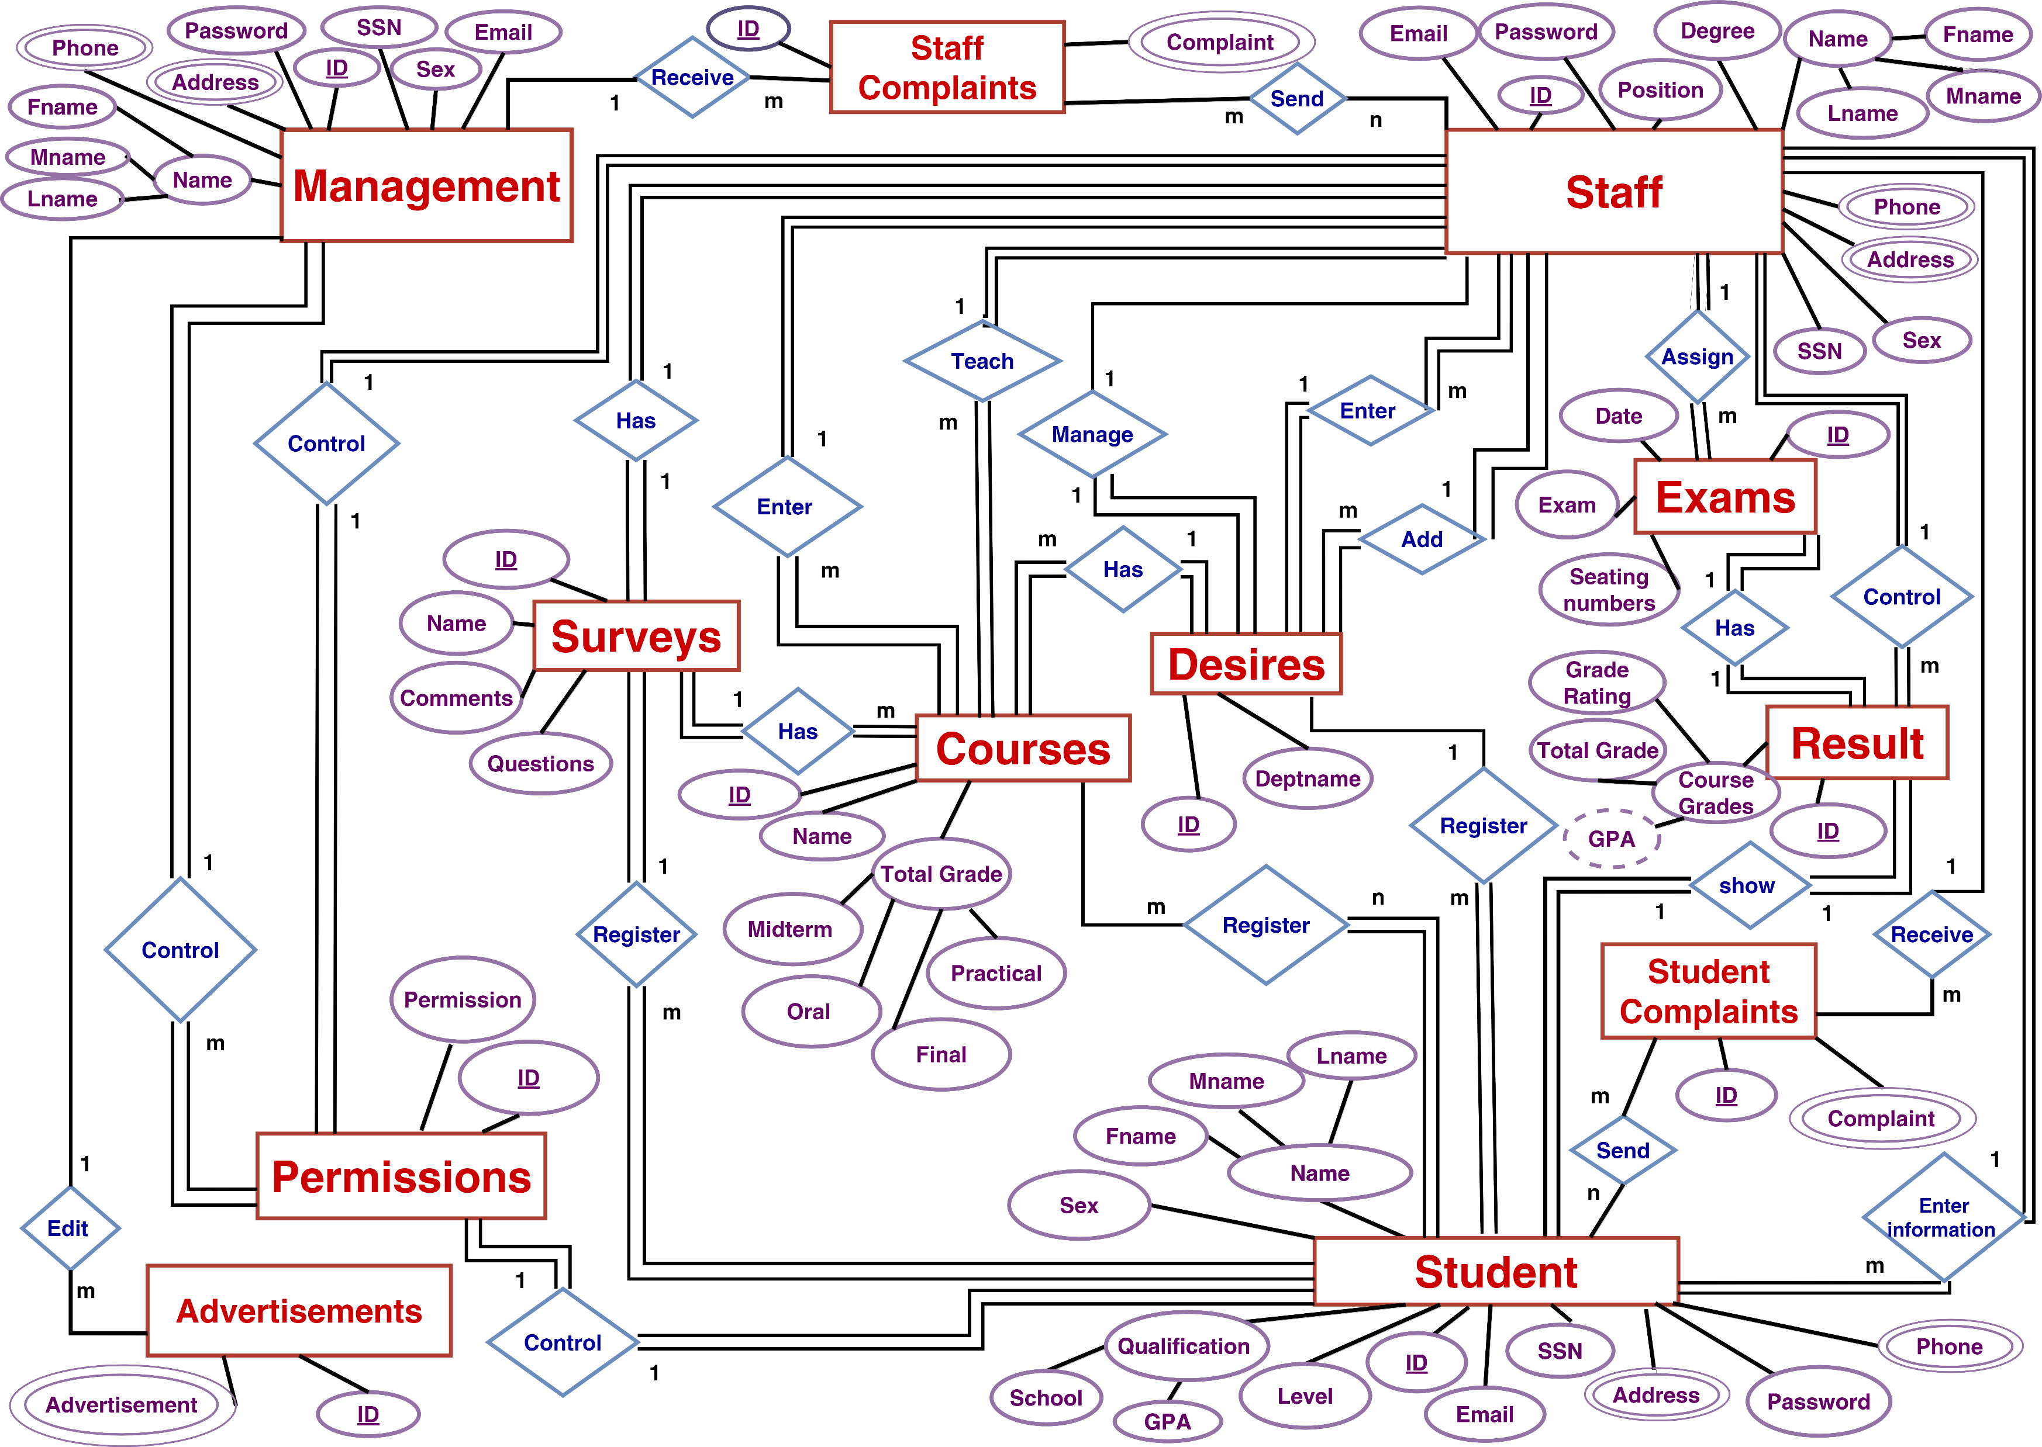

Slide 3
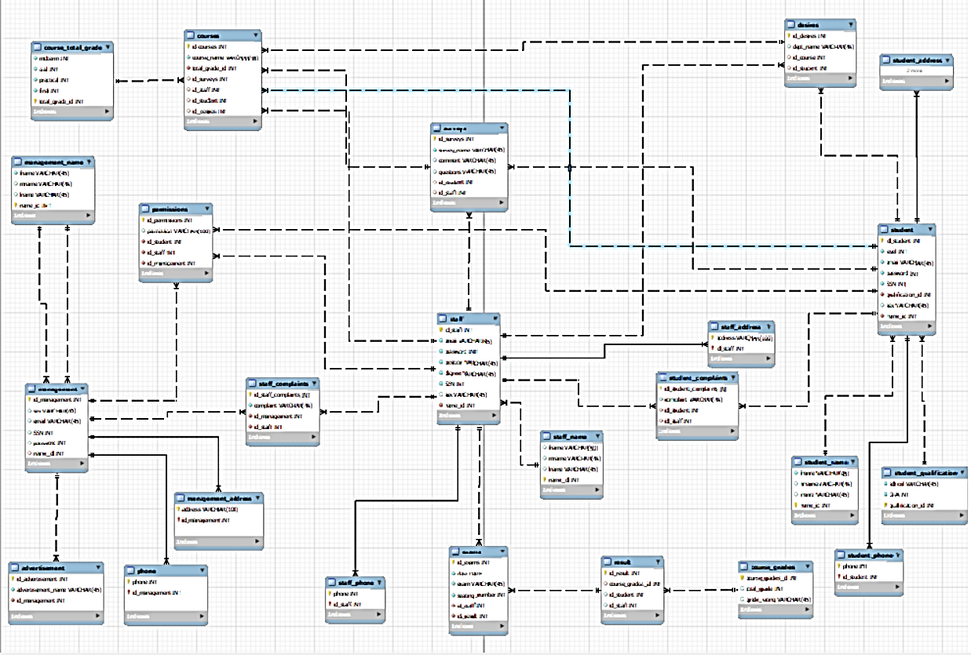

Slide 4
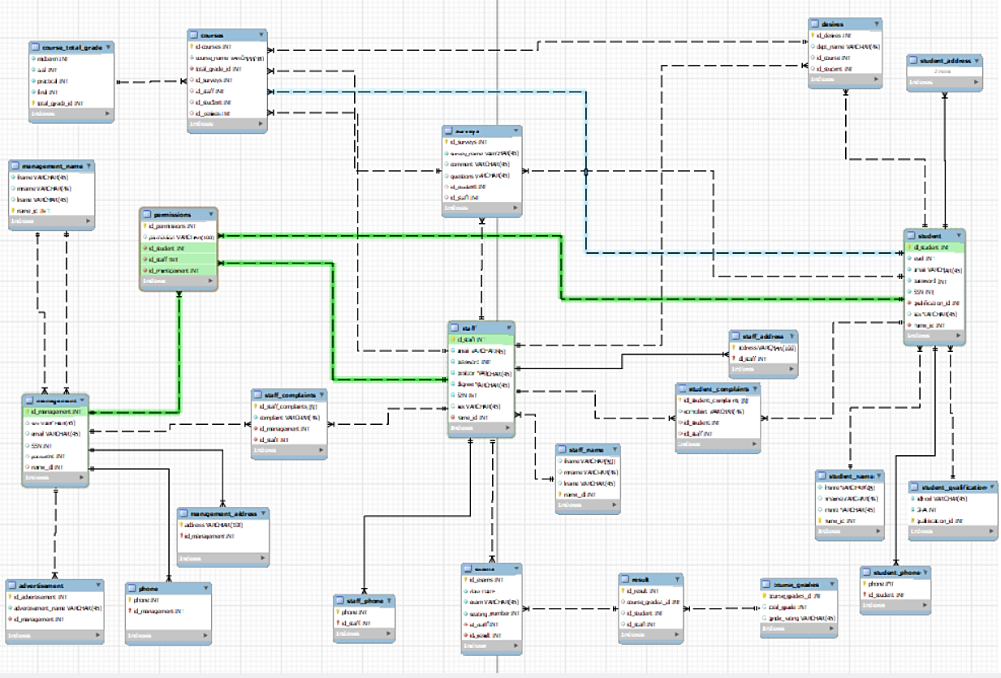

Slide 5
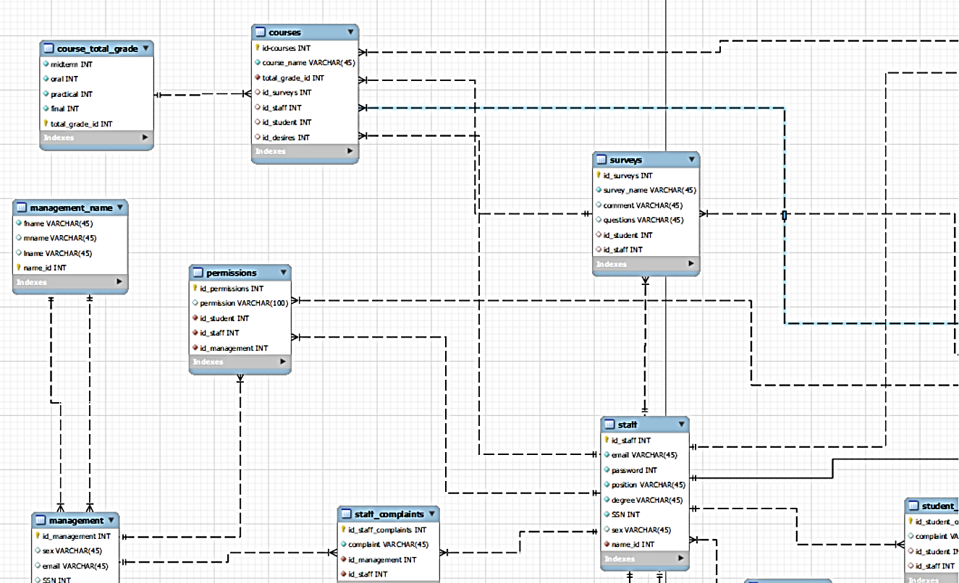

Slide 6
Files of the schema:
https://drive.google.com/drive/folders/1Qcpof6_L5qGM8r1HUUxz4qx5nS179ksY?usp=sharing

